Slide 1
Software Construction and Development
Design Patterns in Java
Khizar Hayat
Email: Khizer.hayat@ucp.edu.pk
Office: Building D, 2^{nd Floor}
OFFICE HOURS: Friday (9:00 to 11:00)

Slide 2
Design Pattern:
Definition:
A design pattern is a reusable solution to a common problem in software design.
It provides a standard way to solve recurring design issues.
Key Points:
Not a finished design or code, but a guideline.
A blueprint to help structure and organize code effectively.

Slide 3
Why Are Design Patterns Important?
Improves Code Reusability
  Saves time and effort by reusing proven solutions.
Enhances Communication
  Creates a shared vocabulary for developers.
Provides Best Practices
  Offers tried-and-tested solutions.
Eases Maintenance
  Helps create flexible and maintainable designs.

Slide 4
Design patterns Usability
Design patterns are programming language independent strategies for solving the common object-oriented design problems.
  That means, a design pattern represents an idea, not a particular implementation.
By using the design patterns you can make your code more flexible, reusable and maintainable.
To become a professional software developer, you must know at least some popular solutions (i.e. design patterns) to the coding problems.

Slide 5
Advantages of Design Patterns
Dis-Advantages of Design Patterns
Reusability
  Saves development time and effort.
Consistency
  Promotes uniform coding practices.
Efficiency
  Offers optimized solutions to common issues.
Readability
  Makes code easier to understand for others.
Complexity
  Can add unnecessary complexity if not used correctly.
Learning Curve
  Requires understanding of the pattern before use.
Overuse Risk
  Applying patterns unnecessarily may complicate the design.

Slide 6
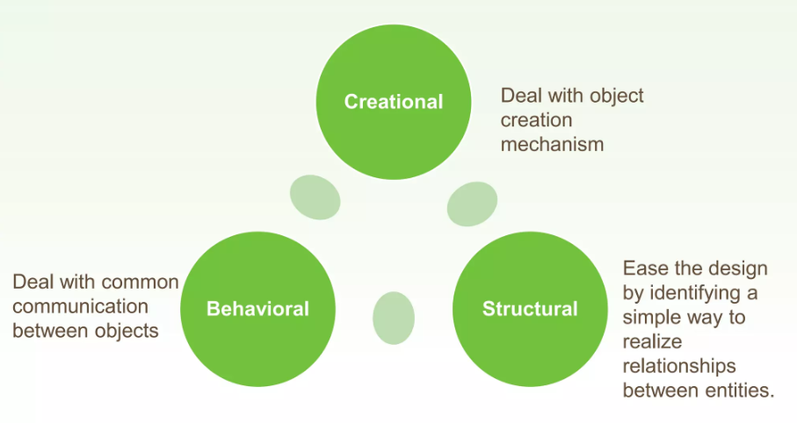
Classification

Slide 7
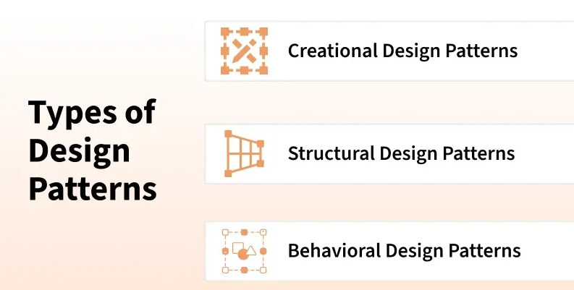

Slide 8
  Creational Design Pattern
Factory Pattern
Abstract Factory Pattern
Singleton Pattern
Prototype Pattern
Builder Pattern.

Slide 9
Structural Design Pattern
Adapter Pattern
Bridge Pattern
Composite Pattern
Decorator Pattern
Facade Pattern
Flyweight Pattern
Proxy Pattern

Slide 10
Behavioral Design Pattern
Chain Of Responsibility Pattern
Command Pattern
Interpreter Pattern
Iterator Pattern
Mediator Pattern
Memento Pattern
Observer Pattern
State Pattern
Strategy Pattern
Template Pattern
Visitor Pattern

Slide 11
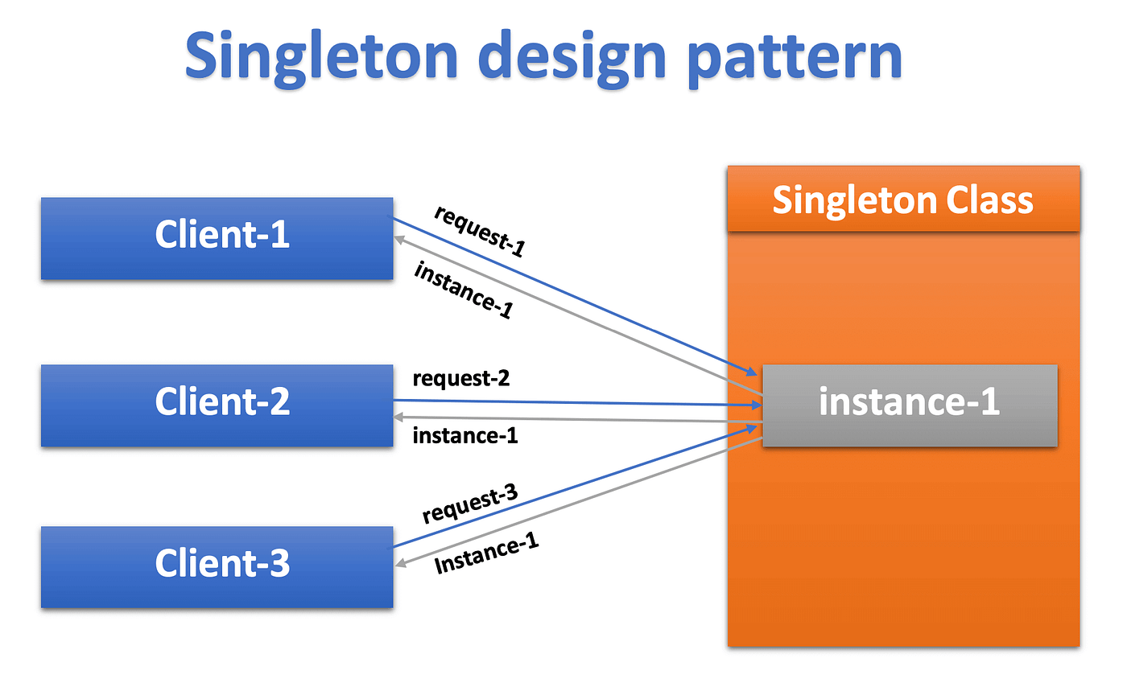
Singleton Design Pattern
The Singleton Design Pattern ensures that:
A class has only one instance and provides a global access point to it.
It is used when we want centralized control of resources, such as managing database connections, configuration settings or logging.
Prevents accidental creation of multiple instances.
Controls resource usage efficiently (e.g., memory, connections).
Can simplify coordination across different parts of an application.
“Singleton is like a shared resource where only one object exists but everyone can use it.”

Slide 12
Real-Life Example: Printer in a Lab
Scenario:
In a computer lab, there is only one printer.
All students send print requests to the same printer.
No matter how many students, the printer remains one shared resource.
Only one instance → Printer
Global access → All students can use it
Controlled usage → No duplicate printers created

Slide 13
Code Example
class Printer {
private static Printer instance;
// private constructor (no one can create object directly)
private Printer() {}
// method to get single printer instance
public static Printer getInstance() {
if (instance == null) {
instance = new Printer();
}
return instance;
}
// method to print document
public void print(String studentName) {
System.out.println(studentName + " is printing document...");
}
}
// Usage
public class Test {
public static void main(String[] args) {
Printer p1 = Printer.getInstance();
Printer p2 = Printer.getInstance();
p1.print("Ali");
p2.print("Sara");
System.out.println(p1 == p2); // true (same printer)
}
}

Slide 14
Factory Pattern
Factory pattern is one of the most used design patterns in Java.
This type of design pattern comes under creational pattern as this pattern provides one of the best ways to create an object.
In Factory pattern, we create object without exposing the creation logic to the client and refer to newly created object using a common interface.

Slide 15
Elements of Factory method Pattern
Abstract Class/ Interface
Concrete Classes
Factory Class: Simple factory generates an instance of an object for client without exposing any implementation to the client.
  In OOP, a factory is an object/class/method for creating other objects.
Client Class

Slide 16
Usage of Factory Method
Factory Design pattern is based on Encapsulation object oriented concept.
Factory method is used to create different object from factory often refereed as Item and it encapsulate the creation code. So instead of having object creation code on client side we encapsulate inside Factory method in Java.

Slide 17
Real-Life Example: Drawing Application
Scenario:
You are using a drawing app (like Paint 🎨)
User selects a shape from menu:
  Circle
  Rectangle
System creates the shape and draws it on screen

Slide 18
Code Example
interface Shape {
void draw();
}
class Circle implements Shape {
public void draw() {
System.out.println("Drawing Circle");
}
}
class Rectangle implements Shape {
public void draw() {
System.out.println("Drawing Rectangle");
}
}
class ShapeFactory {
public static Shape getShape(String type) {
if (type.equals("circle"))
return new Circle();
else if (type.equals("rectangle"))
return new Rectangle();
return null;
}
}
// Usage
public class Test {
public static void main(String[] args) {
Shape s = ShapeFactory.getShape("circle");
s.draw();
}
}

Slide 19
Abstract Factory Pattern
Abstract Factory design pattern is one of the Creational pattern.
Abstract Factory pattern is almost similar to Factory Pattern is considered as another layer of abstraction over factory pattern.
Abstract Factory patterns work around a super-factory which creates other factories.

Slide 20
Elements of Abstract Factory Pattern
AbstractFactory - an interface that is used to create concrete factories.
  Client interact with this interface to access instances of ConcreteFactory concrete subclasses.
ConcreteFactory - A subclass of the Abstract factory, these concrete classes implement the operations/methods which are used to create concrete product objects.
AbstractProduct - The AbstractProduct class is used to declare an interface for a specific type of product object.
  It return the product subclass in relation to the ConcreteFactory which is currently being used to handle product instantiation.

Slide 21
Elements of Abstract Factory Pattern
ConcreteProduct - The concrete product is provided by it’s ConcreteFactory and defines the individual implementation details for the specified product through the implementation of its AbstractProduct interface.
Client - Only uses and has access to the AbstractFactory and AbstractProduct classes, making it completely unaware of the implementation details of the system.

Slide 22
Real-Life Example: Operating System UI (Windows vs Mac)
Scenario:
You are developing a software application that runs on different operating systems:
Windows
Mac
Each OS has its own style of buttons

Slide 23
Code Example
interface Button {
void render();
}
class WindowsButton implements Button {
public void render() {
System.out.println("Windows Button");
}
}
class MacButton implements Button {
public void render() {
System.out.println("Mac Button");
}
}
interface GUIFactory {
Button createButton();
}
class WindowsFactory implements GUIFactory {
public Button createButton() {
return new WindowsButton();
}
}
class MacFactory implements GUIFactory {
public Button createButton() {
return new MacButton();
}
}
// Usage
public class Test {
public static void main(String[] args) {
GUIFactory factory = new WindowsFactory();
Button btn = factory.createButton();
btn.render();
}
}

Slide 24
Observer Pattern
Defines a one-to-many relationship.
When one object (subject) changes, all dependents (observers) are notified.
Used in event systems (e.g., notifications, subscriptions).
👉 Example: Teacher notifies all students

Slide 25
Code Example
import java.util.*;
interface Observer {
void update(String message);
}
class Student implements Observer {
private String name;
public Student(String name) {
this.name = name;
}
public void update(String message) {
System.out.println(name + " received: " + message);
}
}
class Teacher {
private List<Observer> students = new ArrayList<>();
public void addStudent(Observer o) {
students.add(o);
}
public void notifyStudents(String msg) {
for (Observer o : students) {
o.update(msg);
}
}
}
// Usage
public class Test {
public static void main(String[] args) {
Teacher t = new Teacher();
t.addStudent(new Student("Ali"));
t.addStudent(new Student("Sara"));
t.notifyStudents("Assignment uploaded!");
}
}

Slide 26
Decorator Pattern
Used to add new behavior dynamically without modifying the class.
Wraps the original object with additional functionality.
Follows “composition over inheritance”.
👉 Example: Coffee + Milk + Sugar (adding features)

Slide 27
Code Example
interface Coffee {
String getDescription();
double cost();
}
class SimpleCoffee implements Coffee {
public String getDescription() {
return "Simple Coffee";
}
public double cost() {
return 100;
}
}
class MilkDecorator implements Coffee {
private Coffee coffee;
public MilkDecorator(Coffee coffee) {
this.coffee = coffee;
}
public String getDescription() {
return coffee.getDescription() + ", Milk";
}
public double cost() {
return coffee.cost() + 50;
}
}
// Usage
public class Test {
public static void main(String[] args) {
Coffee c = new SimpleCoffee();
c = new MilkDecorator(c);
System.out.println(c.getDescription());
System.out.println(c.cost());
}
}

